Slide 1
Secure Electronic Transaction
(SET)

Slide 2
Learning Outcomes
Definition of SET
SET Services
SET Participants
Dual Signature
Transactions of SET

Slide 3
SET Defintion
Secure electronic transaction (SET) was an early communications protocol used by e-commerce websites to secure electronic debit and credit card payments. Secure electronic transaction was used to facilitate the secure transmission of consumer card information via electronic portals on the internet. Secure electronic transaction protocols were responsible for blocking out the personal details of card information, thus preventing merchants, hackers, and electronic thieves from accessing consumer information.

Slide 4
SET : It is part of web secuirty. It is used to provide security for data among a network.
SET Services:
1. Confidentiality
2. Integrity
3. Authentication
Card Holder Authentication
Merchant Authentication

Slide 5
SET Participants:
Card Holder
Merchant
Issuer
Acquirer
Payment Gateway
Certicate Authority

Slide 6
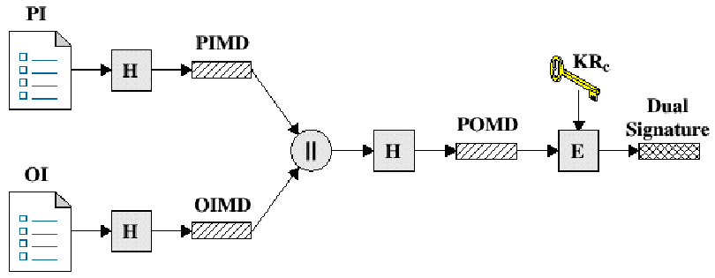
Dual Signature
Generation of Dual Signature:
PI = payment information POMD - payment order message digest
OI = order information KRc - private key of customer
H = hash function (SHA 1) E- encryption (RSA)
PIMD - payment information message digest
OIMD - order information message digest

Slide 7
Dual signature verification process

Slide 8
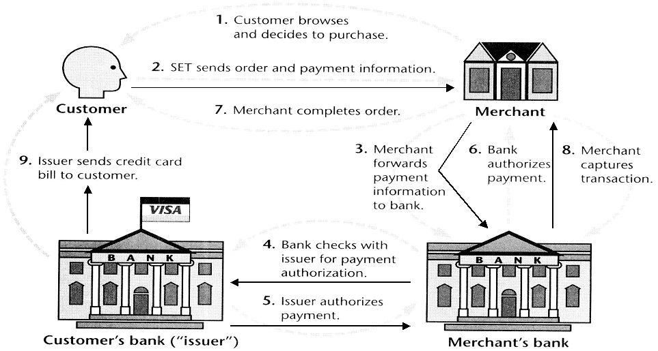
SET Transactions

Slide 9
Transactions involved in SET
3 transactions must be done in this:
1. Purchase Request [ customer to merchant]
2. Payment Authorization [ by financial institution]
3. Payment Capture [request by merchant to Acquirer]

Slide 10
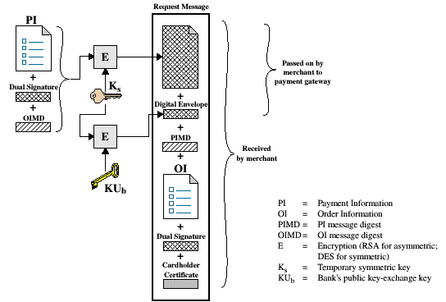
Purchase Request

Slide 11
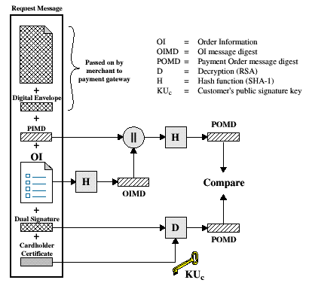
Payment Authentication

Slide 12
Thank you
-N170697

